Slide 1





Slide 2

College of Computing and Informatics Information Technology Program IT489
Senior Project II

Slide 3
Students:
S220017052 S220003861 S220006504 S210054825 S190173769 S220011106
ABDULAZIZ ALOTAIBI FAISAL ALGHANIM OMAR ALALLAF MOHAMMED BIN EID SALEM OMRAN MOHAMMED TALEB
Supervised By
Khalid S. Alwasel

Slide 4


1. Introduction & Problem Statement
Project Objectives & Scope
Literature Review & Methodology
System Design & Architecture
Implementation & Features in Detail
Testing & Results
Future Work
Conclusion
Contents

Slide 5
Project Title
SeeStack: AI-Powered Error Detection and Monitoring System for Developers

Slide 6

Background & Motivation
Modern distributed systems are complex and difficult to monitor.
Developers face fragmented monitoring tools and cryptic logs.
Failures cascade across services, prolonging outages.
AI-powered analysis can unify and accelerate diagnosis.

Slide 7

Problem Description
Uncontextualized error messages and stack traces.
Fragmented tooling: errors, performance, and security live in separate systems.
Manual stress testing is slow and often skipped.
Hidden security misconfigurations remain undetected.

Slide 8

Project Objectives
Build a real-time error and uptime monitoring pipeline.
Integrate OpenAI for automated root-cause analysis and fix suggestions.
Provide bounded stress testing and security scanning capabilities.
Deliver a self-hostable, container-based platform with React dashboard.

Slide 9

Existing Platforms
Sentry: application error tracking and grouping.
Prometheus + Grafana: infrastructure metrics and dashboards.
Datadog: unified observability SaaS platform.
ELK Stack: centralized logging and search.

Slide 10

Gap Analysis
Tools are fragmented; teams switch contexts to correlate signals.
AI-driven remediation guidance is rare or absent in existing tools.
First-party stress testing is missing from most monitoring platforms.
SeeStack closes these gaps in one unified, self-hostable platform.

Slide 11
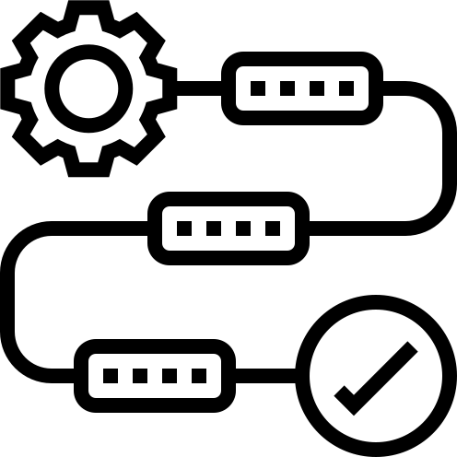
Methodology
Waterfall SDLC with clear, sequential phases.
Spring Boot, Kafka (KRaft), Redis, ClickHouse, PostgreSQL.
React 19 dashboard, OpenAI GPT-4o-mini, Docker Compose.

Slide 12

Project Development Phases
Requirements & Literature Review
Analysis & System Design
Backend, Frontend & SDK Implementation
Integration, Containerization & Testing
Documentation & Submission

Slide 13

Product Features
AI-assisted error analysis with structured remediation.
Runtime error monitoring with fingerprint-based grouping.
Website availability monitoring and bounded load testing.
security scanning (ports + HTTP headers).

Slide 14
System Architecture
SDKs (JavaScript / Java / Python) call the REST ingest API.
Spring Boot backend with Apache Kafka event streaming.
ClickHouse for telemetry and PostgreSQL for relational state.
React 19 dashboard with OpenAI GPT-4o-mini integration.

Slide 15

Database & Design Models
PostgreSQL: users, projects, API keys, monitors, error groups.
ClickHouse: raw error events and monitor checks with TTL.
ER, component, sequence, and deployment diagrams.

Slide 16

Security & Privacy
HTTPS/TLS in transit; AES-256 encryption at rest.
BCrypt passwords; HS256 JWTs; SHA-256 hashed API keys.
One-time ingest-key reveal pattern with safe-prefix display.
PII sanitization of tokens and secrets before LLM dispatch.

Slide 17

Implementation Overview
Java 17 / Spring Boot 3.4.4 backend with seven feature modules.
React 19 + Vite + TypeScript dashboard.
Three zero-dependency SDKs for JavaScript, Java, and Python.
Fumadocs + OpenAPI docs site; Docker Compose deployment.

Slide 18
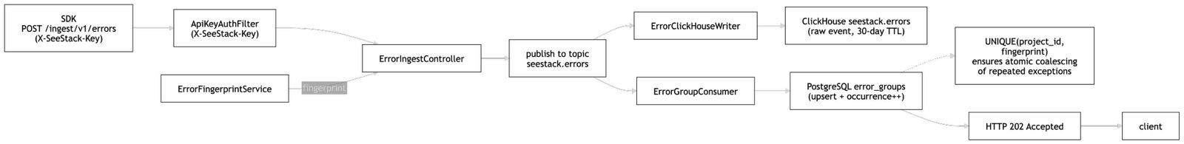
Error Ingestion Workflow

Slide 19
Security Scanning
TCP probe of fixed ports: SSH, HTTP/S, MySQL, PostgreSQL, Redis.
HTTP analyser checks for HSTS, CSP, X-Frame-Options, X-Content-Type.
Additive risk scoring -> LOW (<30), MEDIUM (30-59), HIGH (>=60).
Educational scope: not a CVE-matching production scanner.

Slide 20

Testing & Evaluation
AI explanations rated useful in 92% of evaluated errors.
Average API response: under 200 ms.
End-to-end ingestion verified from SDK to dashboard.

Slide 21

Results & Achievements
Working unified dashboard for errors, monitors, load tests, and security.
Self-hostable in under 30 seconds with a single command.
AI-powered error explanations with privacy-aware redaction.

Slide 22
Future Work
Production-grade AI evaluation harness with regression dataset.
CVE-matching security scanning (Trivy / Snyk integration).
Continuous host-side performance monitoring agent.

Slide 23
Conclusion
All planned objectives met
AI-assisted error analysis is the project's primary novel contribution.
Demonstrates a multi-capability, self-hosted observability platform.

Slide 24


College of Computing and Informatics

Slide 25
Thank You

